Slide 1
INTRODUCTION TO ANGULAR JS
PRESENTER: Umesh M

Slide 2
What is AngularJS?
Angular is client side framework
Angular is used to create web Applications
Angular is mainly used for Single Page Application(SPA) development
Angular is supported on all platforms(Desktop & mobile)
Angular is free & open source
Angular is having cross-browser compatibility.

Slide 3
AngularJS vs Angular ?

Slide 4

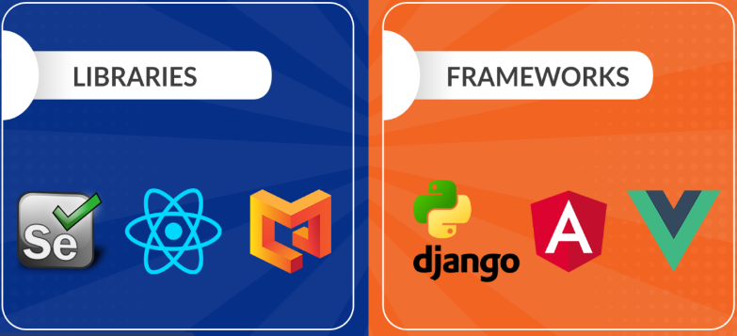

Slide 5
Angular History
Initial version of Angular(1.0) is called AngularJS which is developed using java script.
From 2.0 onwards it is called Angular framework.
Angular 1.x versions are called AngularJS
Angular 2.x and later versions are called Angular framework
Angular 2.x is completely re-written using Type script.
Type script developed by Microsoft company
Current version of Angular is 16

Slide 6
Why do we Choose AngularJS?
Some of the reasons:
AngularJS provides developers an options to write client side applications using JavaScript in a clean Model View Controller (MVC) way.
It provides simple and flexible filters that help us to easily format data
AngularJS applications use less code than traditional JavaScript applications
AngularJS makes Web application and the code very simple to write, test, and maintain.
AngularJS applications need less Document Object Model (DOM) manipulation.

Slide 7
Core Features
The core features of AngularJS are as follows −
MVC
Data-binding
Scope
Controller
Services
Filters
Directives
Templates
Routing
Dependency Injection etc

Slide 8
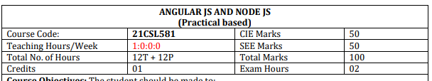
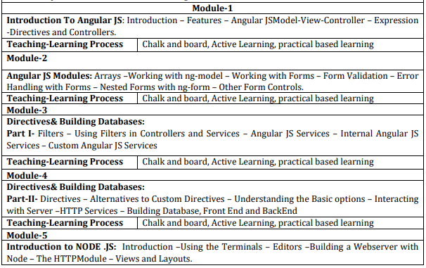

Slide 9
Pre-requisites
Html
Css
Javascript

Slide 10
DOWNLOADING INSTALLING ANGULAR JS

Slide 11
DIRECTIVES & EXPRESSIONS IN ANGULAR JS

Slide 12
DIRECTIVES IN ANGULAR JS
AngularJS lets you extend HTML with new attributes called Directives.
AngularJS has a set of built-in directives which offers functionality to your applications.
AngularJS also lets you define your own directives.
AngularJS directives are extended HTML attributes with the prefix ng-.
The ng-app directive initializes or starts an AngularJS application.

Slide 13
EXPRESSIONS IN ANGULAR JS
AngularJS expression is similar to JavaScript code snippets.
It works with numbers and strings.
{{5+6}}
{{“Hello Student!”}}
It can also work with JavaScript objects and arrays.
{{ user.name }}
{{ items[index] }}
You can write expressions wherever you like, AngularJS will simply resolve the expression and return the result.

Slide 14
AngularJS Expressions vs. JavaScript Expressions
Like JavaScript expressions, AngularJS expressions can contain literals, operators, and variables.
Unlike JavaScript expressions, AngularJS expressions can be written inside HTML.
AngularJS expressions do not support conditionals, loops, and exceptions, while JavaScript expressions do.
AngularJS expressions support filters, while JavaScript expressions do not.

Slide 15
NG-APP DIRECTIVE IN ANGULAR JS

Slide 16
NG-APP DIRECTIVE
Initialization Point: ng-app is an AngularJS directive that specifies the root element where AngularJS will initialize.
It tells AngularJS where your application begins.
In AngularJS, we create single-page applications (SPAs) where most of the application logic resides on a single HTML page.
The ng-app directive defines the boundary of your SPA.

Slide 17
NG-INIT DIRECTIVE IN ANGULAR JS

Slide 18
NG-INIT DIRECTIVE
The ng-init directive initializes application data like variables, arrays, objects, array of objects etc.
It defines the initial value for an AngularJS application and assigns values to the variables.

Slide 19
NG-REPEAT IN ANGULAR JS

Slide 20
NG-REPEAT IN ANGULAR JS
The ng-repeat directive repeats a set of HTML, a given number of times.
The set of HTML will be repeated once per item in a collection.
The collection must be an array or an object.

Slide 21
NG-MODEL & NG-BIND DIRECTIVE IN ANGULAR JS

Slide 22
NG-MODEL DIRECTIVE
With the ng-model directive you can bind the value of an input field to a variable created in AngularJS.
The ng-model directive binds the value of HTML controls (input, select, textarea) to application data.
The ng-bind directive tells AngularJS to replace the content of an HTML element with the value of a given variable, or expression.

Slide 23
mvc IN ANGULAR JS

Slide 24
MVC IN ANGULAR JS
MVC stands for
M – Model – Contains Application Data
V – View – Contains Presentation Logic
C – Controller – Creates communication path between Model and View

Slide 25
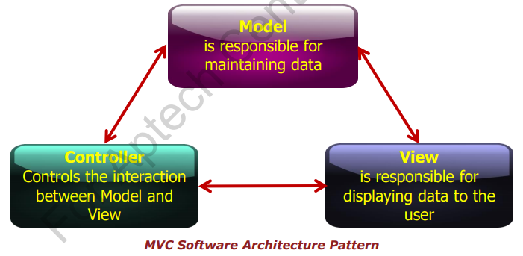
MVC Concepts

Slide 26

REAL LIFE EXAMPLE OF MVC

Slide 27
MVC Concepts
MVC Architecture Pattern
AngularJS supports MVC architecture in software development.
The Model holds the data and logic, the View holds the visual layout and presentation, while the Controller coordinates the Model and View.

Slide 28
<html ng-app="myApp">
<script src="angularjs.js"></script>
<script>
var app = angular.module("myApp", []);
app.controller("myController", function($scope) {
$scope.message = "Welcome to JSS";
});
</script>
<body ng-controller="myController">
<div >
<h2>{{message}}</h2>
<h2 ng-bind="message"></h2>
</div >
</body>
</html>

Slide 29
Modules
It is a container used to hold other parts of an application.
It has the option to define its own controllers, services, filter, directives, and so on.

Slide 30
CONTROLLERS
AngularJS applications depend on controllers to control the flow of data in the application.
We add ‘myController’ to the app using the app.controller() method.
app.controller("myController",function($scope)
{
$scope.name = "";
});
Controllers are JavaScript objects which have properties and functions.
We use a controller in an application by using “ng-controller” directive.

Slide 31
CONTROLLERS
Responsibilities of Controllers
Making available Data to UI
Managing presentation
Handling user inputs
Processing data

Slide 32
SCOPE IN ANGULAR JS

Slide 33
SCOPE IN ANGULAR JS
The scope of AngularJS is the model.
It is a JavaScript object with properties and methods available for both the view and the controller.
The scope is the binding part between the HTML (view) and the JavaScript (controller).
The scope is an object with the available properties and methods.
The scope is available for both the view and the controller.

Slide 34
How to Use the Scope?
When you make a controller in AngularJS, you pass the $scope object as an argument.
Syntax:
app.controller('myCtrl', function($scope) {
$scope.carname = "Volvo";
});

Slide 35
How to Use the Scope?
When adding properties to the $scope object in the controller, the view (HTML) gets access to these properties.

Slide 36
Understanding the Scope
If we consider an AngularJS application to consist of:
View, which is the HTML.
Model, which is the data available for the current view.
Controller, which is the JavaScript function that makes/changes/removes/controls the data

Slide 37
Understanding the Scope
The $scope is glue between a controller and view (HTML). It transfers data from the controller to view and vice-versa.
VIEW
MODEL

Slide 38
Understanding the Scope
As we have seen in the controller section, we can attach properties and methods to the $scope object inside controller function.
The view can display $scope data using an expression, ng-model, or ng-bind directive

Slide 39
DATA BINDING IN ANGULAR JS

Slide 40
What is data binding?
Data binding is a process of combining data between the model and the view.

Slide 41
TYPES OF DATA BINDING
1. ONE WAY DATA-BINDING
2. TWO WAY DATA-BINDING

Slide 42
1. ONE WAY DATA-BINDING
MODEL
DATA FLOWS FROM
MODEL TO VIEW ONLY
VIEW

Slide 43
ONE WAY DATA-BINDING
One-way data binding in AngularJS means binding data from Model to View.
In one way data- binding data flows from the scope/controller to the view
'ng-bind' is an angular directive used for achieving one-way data binding

Slide 44
TWO WAY DATA-BINDING
MODEL
DATA FLOWS FROM
VIEW TO MODEL
DATA FLOWS FROM
MODEL TO VIEW
VIEW

Slide 45
TWO WAY DATA-BINDING
Two Way Data binding is the synchronization between the model and the view.
When data in the model changes, the view reflects the change, and when data in the view changes, the model is updated as well.
'ng-model' is an angular directive used for achieving two-way data binding

Slide 46
FILTERS IN ANGULAR JS

Slide 47
Filters
Filters can be added in AngularJS to format data.
They format the value of an expression for displaying to the end user.
They are added to expressions by using the pipe character |, followed by a filter.
Filters can be used in view templates as well as in controllers.

Slide 48
AngularJS Filters
AngularJS provides filters to transform data:
Lowercase - Format a string to lower case.
Uppercase - Format a string to upper case
Number - Format a number to a string.
Currency - Format a number to a currency format.
Date - Format a date to a specified format.

Slide 49
DATE FILTER
The date filter formats a date to a specified format.

Slide 50
FORMATS FOR DATE FILTER
"yyyy" year (2016)
"yy" year (16)
"y" year (2016)
"MMMM" month (January)
"MMM" month (Jan)
"MM" month (01)
"M" month (1)

Slide 51
FORMATS FOR DATE FILTER
"dd" day (06)
"d" day (6)
"EEEE" day (Tuesday)
"EEE" day (Tue)

Slide 52
FORMATS FOR TIME IN DATE FILTER
"HH" hour, 00-23 (09)
"H" hour 0-23 (9)
"hh" hour, 00-12 (09)
"h" hour, 0-12 (9)
"mm" minute (05)
"m" minute (5)

Slide 53
FORMATS FOR TIME IN DATE FILTER
"ss" second (05)
"s" second (5)
"sss" millisecond (035)
"a" (AM/PM)

Slide 54
FORMATS FOR DATE FILTER
The format value can also be one of the following predefined formats:
"short" same as "M/d/yy h:mm a" (1/5/16 9:05 AM)
"medium" same as "MMM d, y h:mm:ss a" (Jan 5, 2016 9:05:05 AM)
"shortDate" same as "M/d/yy" (1/5/16)
"mediumDate" same as "MMM d, y" (Jan 5, 2016)
"longDate" same as "MMMM d, y" (January 5, 2016)
"fullDate" same as "EEEE, MMMM d, y" (Tuesday, January 5, 2016)

Slide 55
FORMATS FOR DATE FILTER
The format value can also be one of the following predefined formats:
"shortTime" same as "h:mm a" (9:05 AM)
"mediumTime" same as "h:mm:ss a" (9:05:05 AM)

Slide 56
Order-by filter IN ANGULAR JS

Slide 57
orderBy Filter
It will provide sorting of arrays in ascending or descending order.

Slide 58
EVENTS and event HANDLING IN ANGULAR JS

Slide 59
What are Events?
Events are "things" that happen to HTML elements.
AngularJs can "react" on these events.
Here are some examples of events:
An HTML web page has finished loading
An HTML input field was changed
An HTML button was clicked

Slide 60
Mouse Events
On Mouse click
ng-click
ng-mousedown
ng-mouseup
ng-dblclick

Slide 61
Mouse Events
Mouse events occur when the cursor moves over an element, in this order:
ng-mouseover
ng-mouseenter
ng-mousemove
ng-mouseleave

Slide 62
ng-change directive
The ng-change directive tells AngularJS what to do when the value of an HTML element changes like textbox, select, textarea.
The ng-change directive requires a ng-model directive to be present.
The ng-change event is triggered at every change in the value. It will not wait until all changes are made, or when the input field loses focus.
The ng-change event is only triggered if there is a actual change in the input value, and not if the change was made from a JavaScript.

Slide 63
KeyBoard Events
Executes when we enter a keyboard button.
ng-keydown
ng-keypress
ng-keyup

Slide 64
Copy Paste Events
Executes when do some cut copy paste operation on input fields.
ng-copy
ng-cut
ng-paste

Slide 65
NG-INCLUDE DIRECTIVE IN ANGULAR JS

Slide 66
NG-INCLUDE DIRECTIVE
The ng-include directive includes HTML from an external file.
The included content will be included as child nodes of the specified element.
By default, the included file must be located on the same domain as the document.

Slide 67
NG-SHOW AND NG-HIDE DIRECTIVES IN ANGULAR JS

Slide 68
NG-SHOW DIRECTIVE
The ng-show directive shows the specified HTML element if the expression evaluates to true, otherwise the HTML element is hidden.

Slide 69
NG-HIDE DIRECTIVE
The ng-hide directive hides the HTML element if the expression evaluates to true.
ng-hide is also a predefined CSS class in AngularJS, and sets the element's display to none.

Slide 70
FORM VALIDATION IN ANGULAR-JS

Slide 71
Introduction to Forms Validation
Forms are the major way users communicate with the apps we develop and are an important mechanism of modern Websites and applications.
They are used to collect data form the users.
The data collected by the form is validated before sending it to the server.
AngularJS continuously oversees the status of the form and their input fields such as input, textarea, select and help us advise the user about the current state.

Slide 72
Form states
Form is a collection of related individual controls grouped together. For example, Login form -> allows users to input their credential to enter the application.
Angular Form has some additional capabilities than plain HTML forms.
It gives developers more control on how to communicate with the form.
While creating Angular form, AngularJS creates an instance of FormController.

Slide 73
Properties
$untouched: The field has not been touched yet
$touched: The field has been touched
$pristine: The field has not been modified yet
$dirty: The field has been modified
$invalid: The field content is not valid
$valid: The field content is valid

